Slide 1
Merchandise Management System
Presented By
Babla Dey
Under the Supervision of :
Farzina Akther
Lecturer,
Dept. of CSE
Port City International University

Slide 2
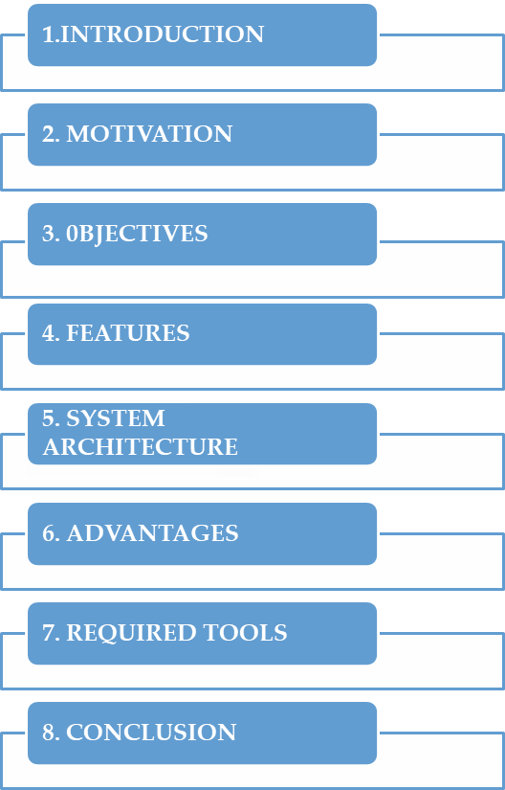
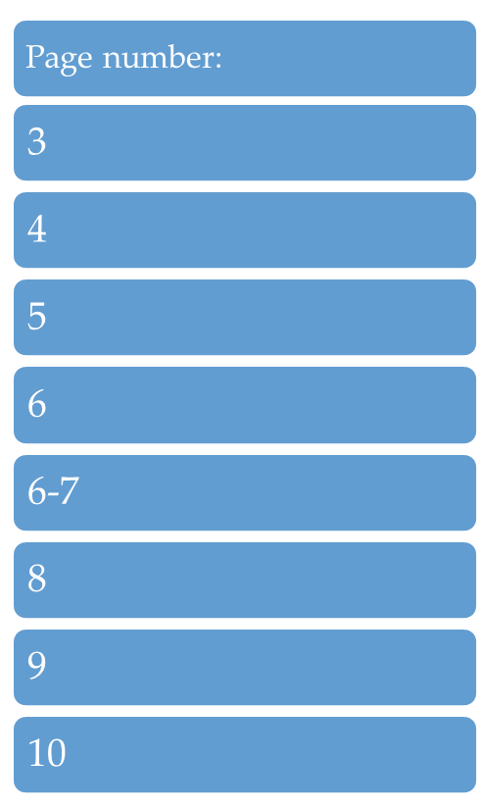
OUTLINE

Slide 3

INTRODUCTION

Slide 4
MOTIVATION
To make automated the current system.
To Modernization of the sytem
Automated with notification to remind the merchandiser about his inventory

Slide 5
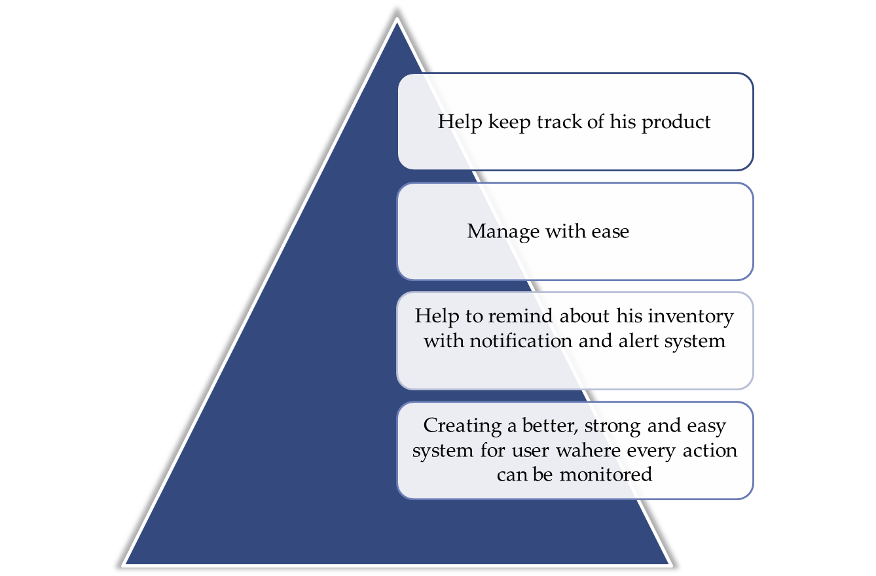
Objective

Slide 6
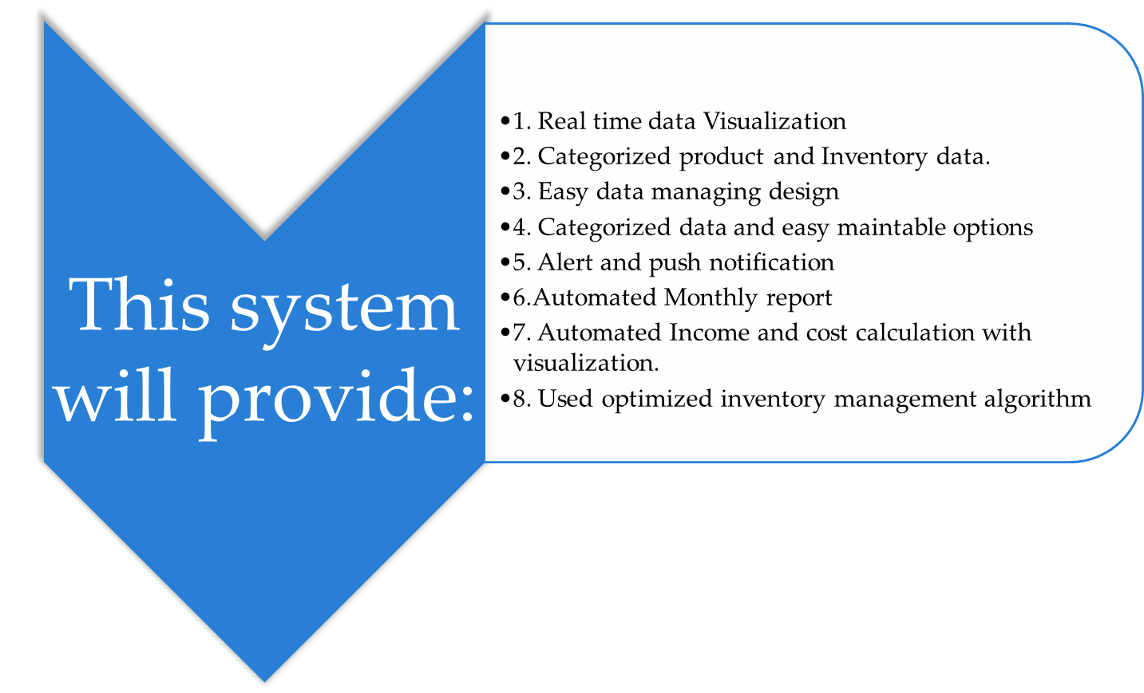
Features

Slide 7


System Architecture
Manage Total Budget
Manage Total Cost
Manage Product
Admin Login
Merchandiser
Manage Product Category
Try<5
Manage Buy item
Authentication
SignUp-SignIn
No
Track Product
Yes
Search
Price list of product
Admin Panel CMS
Merchandiser activity
History of Payment
Calculation
Log-Out
Manage Contact Us

Slide 8
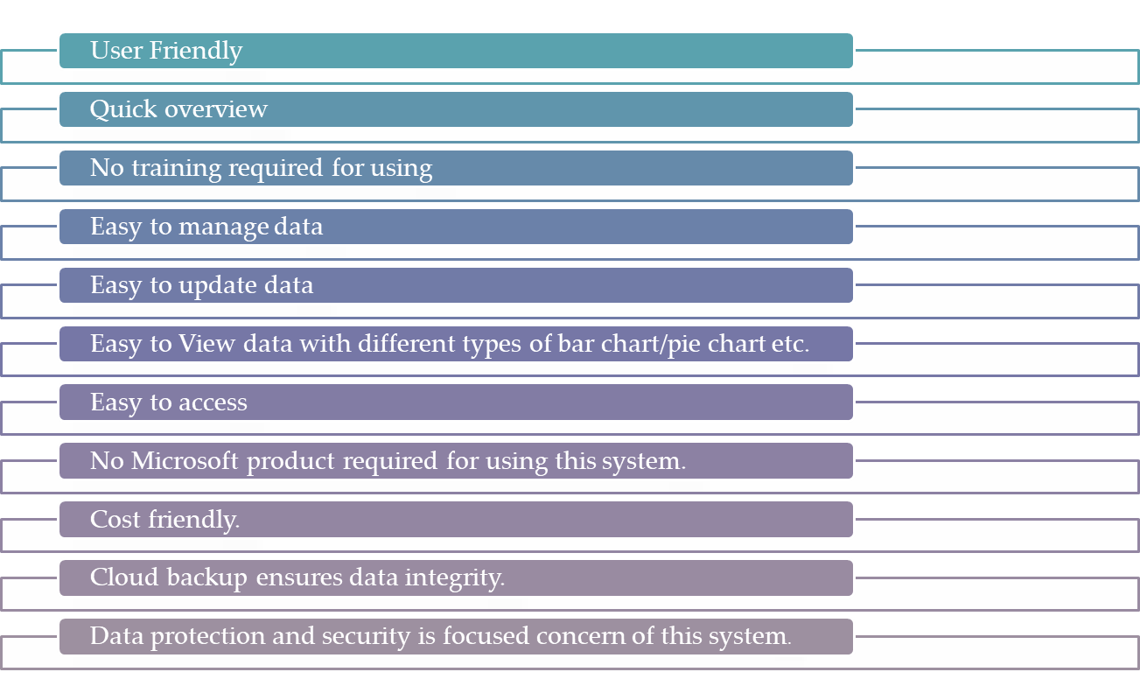
Advantages

Slide 9


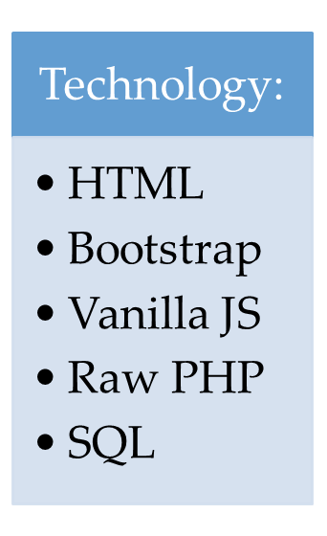
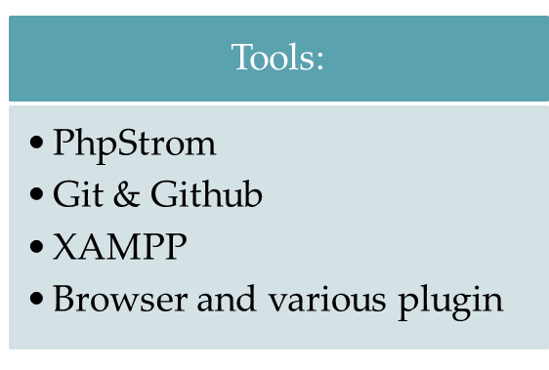
Required tools and technology

Slide 10
Conclusion
This system will help and provide the necessary managing option where Information
Will be flawless and it can help to reduce response time and maintain proper logistic
and responses.

